Slide 1










THREE MAIN HEADINGS
ISYA 2024 PROJECT
OPEN CLUSTER
PLATAIS 2 HIP 5671
SSS TEAM
Target Selection
Observation
Requirements
Ayoub Sarri
-Algeria-
Sena Aleyna
Şenturk
-Turkey-
Sam Samuneti
Nigeria
Data Reduction
and Results

Slide 2
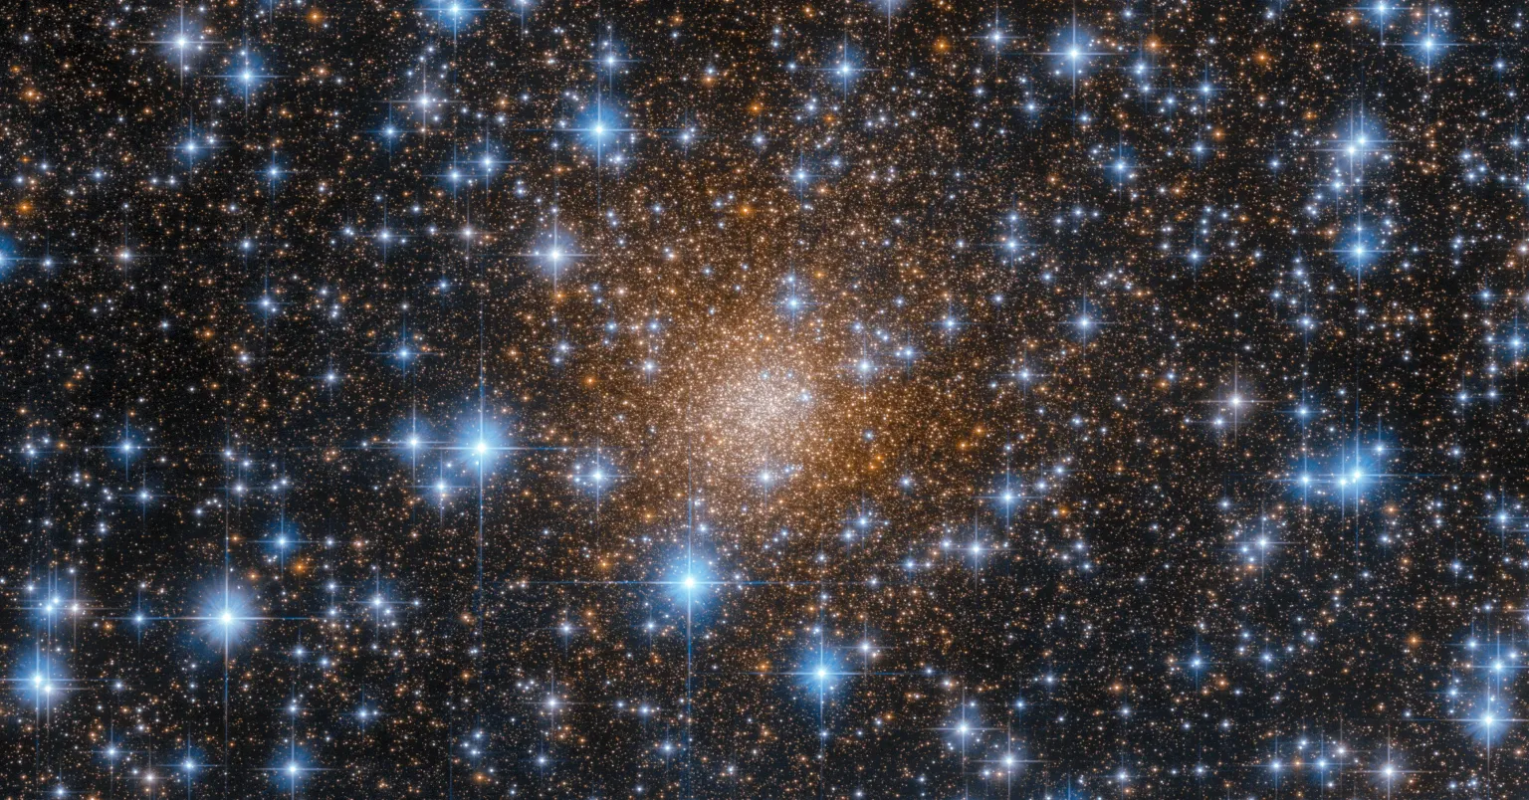
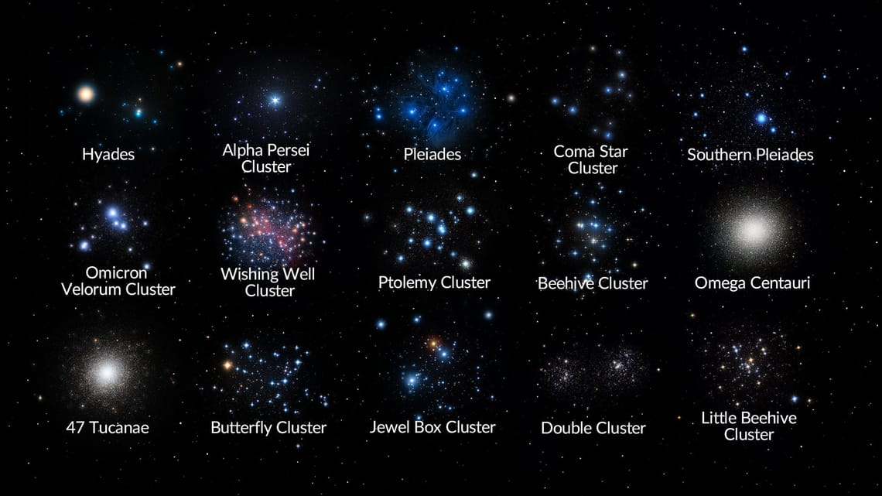
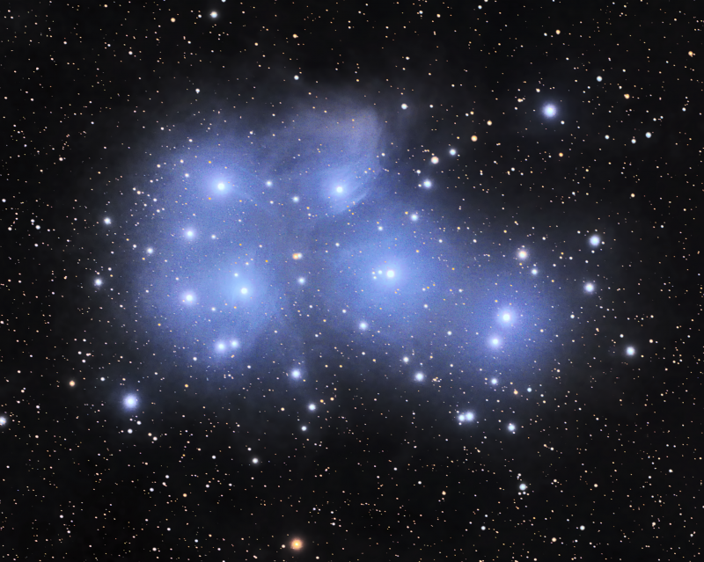
What are Open Clusters?
Open clusters are groups of stars that are loosely bound by gravitational forces, formed from the same molecular cloud.
They typically contain a few hundred to a few thousand stars.
Characteristics:
Stars of similar age and chemical composition.
Located in spiral arms and the galactic disk.
Importance: Crucial for studying stellar evolution.Key to understanding the life cycle of stars and the Milky Way.

Slide 3
PRESENT A BRIEF OVERVIEW OF THE PROJECT
The Aim of this Study is to Analyze The : PLATAIS 2 -Open Cluster- using :
Photometric Techniques Generate an HR Diagram
This analysis will help
Classify the Stars within the Cluster and Provide Insights into its Stellar Properties
Platais 2 holds significant interest due to its relatively limited coverage in scientific literature,
With only 33 known Studies 😲
By selecting this Cluster, we aim to contribute to the understanding of its :
Stellar Population + Age + Evolution 👀
The observations were conducted using : B and V Filters, ideal for creating an accurate color-magnitude diagram.

Slide 4




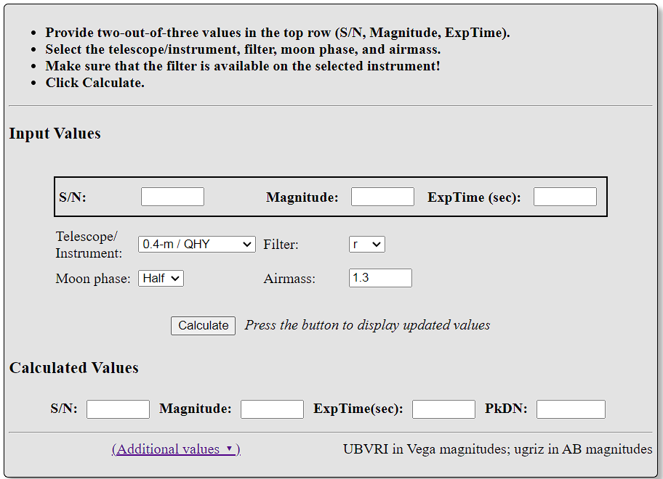
Observational Details
Observatory
McDonald Observatory (LCOGT)
Telescope: 0.35-meter (0m4-14)
Location: Latitude: 30.6800415° N, Longitude: -104.0150660° E, Altitude: 2030 m
Environmental Conditions:
Temperature: 17.6°C
Humidity: 75%
Sky Brightness: 21.3
Airmass: 1.024
Target Object: HIP 5671 Cluster
Observation Date: 2024-09-25
Start Time: 06:54:42 UTC
End Time: 07:36:42 UTC
B_Filtre and V_Filtre
QHY600 CMOS camera
Total Exposure Time: Dark + Flat + B + V = (3 ×320 seconds) x 3 = 64 miniutes
Las Cumbres Calculator
Observation Parameters:

Slide 5
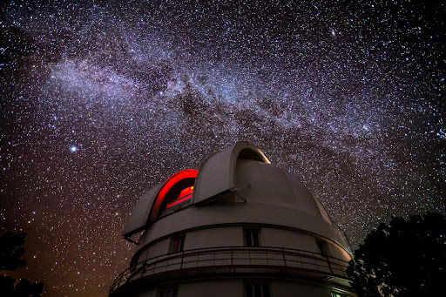
TARGET SELECTION (WHY PLATAIS 2?)
Location: Ideal for observations from the Northern Hemisphere (Dec > 0) at McDonald Observatory
Max Altitude
04
Equipment
reaches a maximum altitude of 88 degrees, ensuring optimal atmospheric conditions and reducing atmospheric distortion.
01
The 0.35-meter telescope, equipped with a QHY600 CMOS camera, is well-suited for high-quality photometric observations of the cluster’s stars, providing a wide dynamic range and low readout noise for precise brightness measurements.
02
03
Field of View
Distance to Moon
The selected date aligns with favorable meteorological conditions, with the moon being 64% full, ensuring minimal interference from moonlight and optimal conditions for observations.
The camera’s field of view 1.28 degrees perfectly accommodates the approximately 8 Arcminute apparent diameter of Platais 2, allowing comprehensive coverage of the cluster.

Slide 6

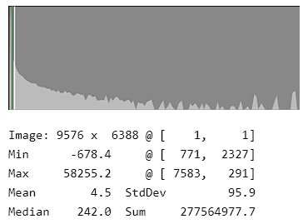
Data Collection
FITS Files Overview:
Total Images Collected:
3 Raw Images in B Band:
elp0m414-sq31-20240924-0249-e00.fits
elp0m414-sq31-20240924-0250-e00.fits
elp0m414-sq31-20240924-0251-e00.fits
3 Processed Images in B Band:
elp0m414-sq31-20240924-0249-e91.fits
elp0m414-sq31-20240924-0250-e91.fits
elp0m414-sq31-20240924-0251-e91.fits
3 Raw Images in V Band:
elp0m414-sq31-20240924-0249-e00.fits
elp0m414-sq31-20240924-0250-e00.fits
elp0m414-sq31-20240924-0251-e00.fits
3 Processed Images in V Band:
elp0m414-sq31-20240924-0249-e91.fits
elp0m414-sq31-20240924-0250-e91.fits
elp0m414-sq31-20240924-0251-e91.fits
Observation Summary:The collected images were analyzed for quality and clarity.Initial assessments indicate that the data quality is sufficient for further analysis, showcasing clear features of the target object.

Slide 7
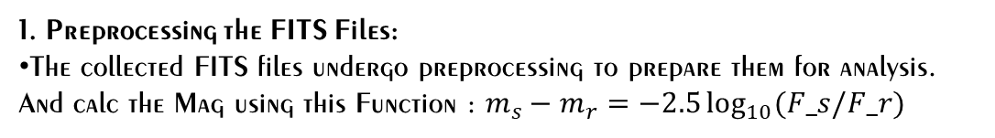
Data Reduction (Method)
1. Preprocessing the FITS Files:
The collected FITS files undergo preprocessing to prepare them for analysis. And calc the Mag using this Function : $m_{s}−m_{r}=−2.5\log_{10}{(F_s/F_r)}$
2. Coordinate Matching:
Tools Used:
SkyCoord for celestial coordinates.
pandas for DataFrame
Process:
Selected 3 Processed Images from each filter (B and V).
Cross-matched the tables of B and V with a tolerance of 5 arcseconds.
3. Cross-Matching with SIMBAD Catalogue:
Utilized astroquery to cross-match the result tables of B and V with the SIMBAD astronomical database.
Results:Generated two tables: B_Table and V_Table that contains 577 entries in the column labeled "star."

Slide 8
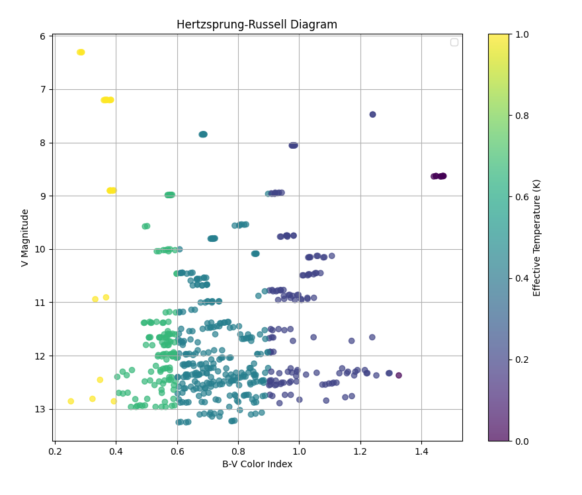
Results - HR Diagram and Spectral Classification
HR Diagram:
X-axis: B-V color index
Y-axis: V magnitude (inverted) to reflect the decreasing brightness with increasing values.
The diagram was plotted using matplotlib.pyplot, utilizing color gradients to represent effective temperature for each star in the Platais 2 cluster.
Effective Temperature and Spectral Classification:
Stars were classified based on their B-V color index, using the following ranges:
O-type: < -0.3 (30,000 K) B-type: -0.3 to 0.0 (20,000 K) A-type: 0.0 to 0.4 (10,000 K) F-type: 0.4 to 0.6 (7,500 K)
G-type: 0.6 to 0.9 (5,700 K) K-type: 0.9 to 1.3 (4,000 K)
M-type: > 1.3 (2,500 K)
A color gradient from viridis colormap was used to visually map the effective temperatures.

Slide 9
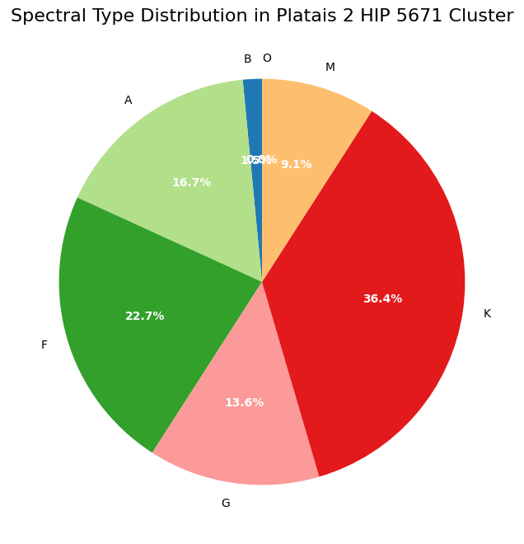
Results - Spectral Type Distribution
Spectral Type Distribution:
B-type: 1.5%
G-type: 13.63%
K-type: 36.36%
F-type: 22.72%
A-type: 16.66%
M-type: 9.09%
Spectral type distribution was also visualized using a pie chart for clearer understanding of the star population.
Figure:
The HR diagram and spectral distribution charts were generated and saved using matplotlib.pyplot for further analysis

Slide 10






Analysis of Stellar Properties
Effective Temperatures:
Impact of Cluster Age
& Evolutionary Stage
Effective Temperatures
The stars in Platais 2 span a wide range of effective temperatures, from 2500 K for M-type stars to around 10,000 K for A-type stars.
G and K-type stars, which dominate the cluster, have effective temperatures between 4000 K and 5700 K, indicating their mid-life stage on the main sequence.
The presence of A-type stars, along with the dominance of F, G, and K stars, suggests that Platais 2 is a moderately young cluster.
The M-type stars, though fewer, represent more evolved or lower mass stars, offering clues about the later stages of stellar evolution within the cluster.

Slide 11




Stellar Population and Cluster Age
Discussion on Cluster Age:
Based on the spectral types and their distribution, Platais 2 is estimated to be a relatively young cluster, likely aged between 100 to 300 million years.
The cluster's stellar population suggests it is still in the process of losing its hot, blue stars (B types), while the remaining stars are transitioning into later evolutionary stages.
Summary
Platais 2 offers a valuable opportunity to study stellar evolution, especially the transition of stars from the main sequence to later stages like red giants.

Slide 12
Conclusion
Summary of Findings
01
Successfully observed and analyzed the open cluster Platais 2, generating an HR diagram and determining the spectral type distribution.
The cluster is dominated by K and F-type stars, with a smaller presence of A, G, M, and B types, indicating a moderately young cluster
Future Work:
Future analysis will focus on isochrone fitting to estimates The ageS, Distances, and metallicity, Evolutionary Stages of Stars in a Cluster.
Additional cross-matching with catalogs and deeper photometry could uncover more faint or less visible members of Platais 2.
Key Insights:
02
The abundance of K and F-type stars suggests an estimated age of 100-300 million years, with active stellar evolution occurring.
The HR diagram reveals the cluster’s main-sequence stars, providing a foundation for further analysis of its stellar characteristics.
03

Slide 13



Thanks!
SCAN ME
A sincere thank you to all the professors and organizers of the International School for Young Astronomers (ISYA) for their incredible support and guidance. This experience has expanded our knowledge and passion for astronomy.
Gratitude also to my fellow participants for their collaboration and friendship throughout this journey. Together, we have made lasting memories and grown as young astronomers. Thank you!

